Slide 1
Class and Objects

Slide 2
Object
Any Real World Entity Which having well defined structure and behaviour
It is a run time entity
Instance of class
It can be Tangible or Intangible entity
E.g. Car , Mobile , Bank Account

Slide 3
Class
Class is a Template / blueprint to create Objects
It is a Logical Entity
Java Class can Contains
  Field / Variable
  Method / Function
  Constructor
  Blocks
  Nested Class and interface

Slide 4
class <class_name>{
field; <data type> <var name>
method; <return type> method name ()
}

Slide 5
Types of Variable
Instance Variable
A variable which is created inside the class but outside the method is known as an instance variable. Instance variable doesn't get memory at compile time. It gets memory at runtime when an object or instance is created. That is why it is known as an instance variable.
Local Variable
A variable which created inside Method or block

Slide 6
Methods
In Java, a method is like a function which is used to expose the behavior of an object.
Advantage of Method
Code Reusability
Code Optimization

Slide 7
new Keyword
The new keyword is used to allocate memory at runtime. All objects get memory in Heap memory area.
<Class Name> <Ref> ;
Employee e ;
<Ref> = new <Class Name>();
e = new Employee(); // allocating memory

Slide 8
Static Keyword
The static keyword in Java is used for memory management mainly.
We can apply static keyword with variables, methods, blocks and nested classes.
The static keyword belongs to the class than an instance of the class.

Slide 9
Java static method
If you apply static keyword with any method, it is known as static method.
A static method belongs to the class rather than the object of a class.
A static method can be invoked without the need for creating an instance of a class.
A static method can access static data member and can change the value of it.

Slide 10
Java static block
Is used to initialize the static data member.
It is executed before the main method at the time of classloading.

Slide 11
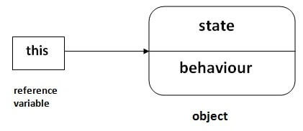
this keyword in java
In Java, this is a reference variable that refers to the current object.

Slide 12
to refer current class instance variable
to invoke current class method
to invoke current class constructor
can be used to return current class instance

Slide 13
final keyword
To declare constant in java we can use final keyword for variable
final <data type> <var name>;
Once it is initialised value can not change

